Slide 1


Slide 2

Welcome to the 2026 World Congress
OARSI welcomes you to West Palm Beach!

Slide 3
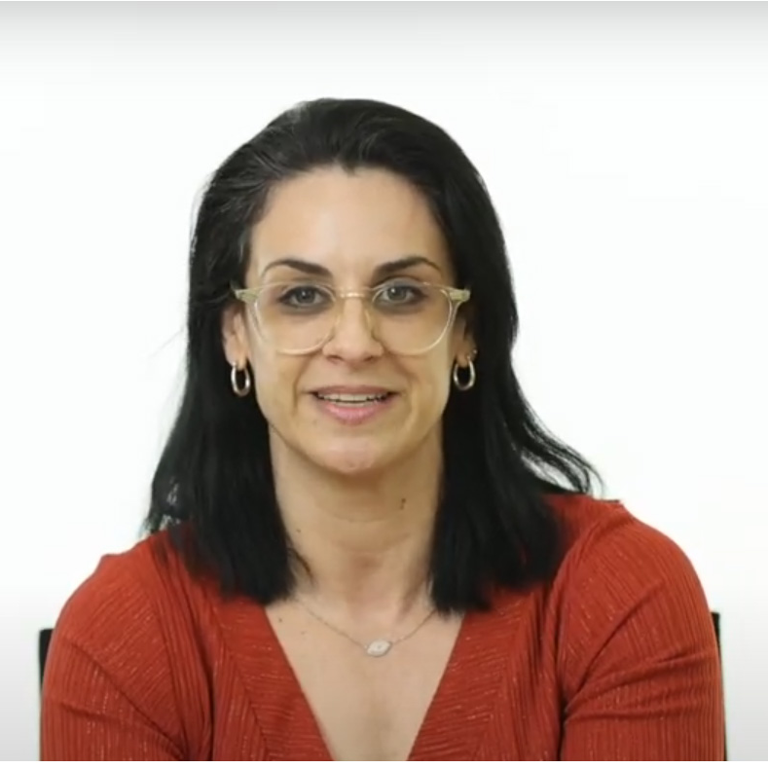
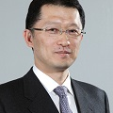
2024 Program Committee Chairs
Thank you 2026 Program Committee Chairs
Congress Chair
Cindy Boer, PhD
Hebrew University of Jerusalem
Netherlands
Abstract Chair
Jessica Bertrand, PhD Juntendo University Germany

Slide 4
Thank you 2026 Program Committee
Jessica Bertrand, Germany
Marie Binvignat, France
Cindy Boer, The Netherlands
Thomas Hügle, Switzerland*
Mohammed Jarraya, USA
Matlock Jeffries, USA
Raghunatha Yammani, USA
Siyi Zhu, China
Armaghan Mahmoudian, US, Local Champion
Merry? US, Local Champion
Thomas Link, US Board Liaison
* indicates rotating off committee after 3-year term

Slide 5


Thank You 2025 Corporate Members

Slide 6

Thank you to our World Congress Sponsors!

Slide 7

Thank You World Congress Exhibitors

Slide 8

Access Wifi
Download the Mobile App

Slide 9

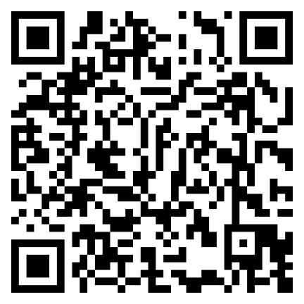
We Want to Hear From You! Tell Us Highlighted Speakers and Topics You Would Like to Hear at OARSI 2026 in West Palm Beach, Florida.
Notes:
https://youtu.be/X0Q7YQrJ4eQ - vienna

Slide 10
OARSI Live! Webinar Series
Recent topics include:
Role of AI in Imaging
Causal Inference+ Confounding: Practical Considerations for Study Design+ Analysis
Implementing Wearable Sensors In OA Research
Patient Engagement in Research
Free for members
Recordings available on OARSI website
Organized by the Engagement Committee. If you have ideas for webinar topics, let us know!

Slide 11
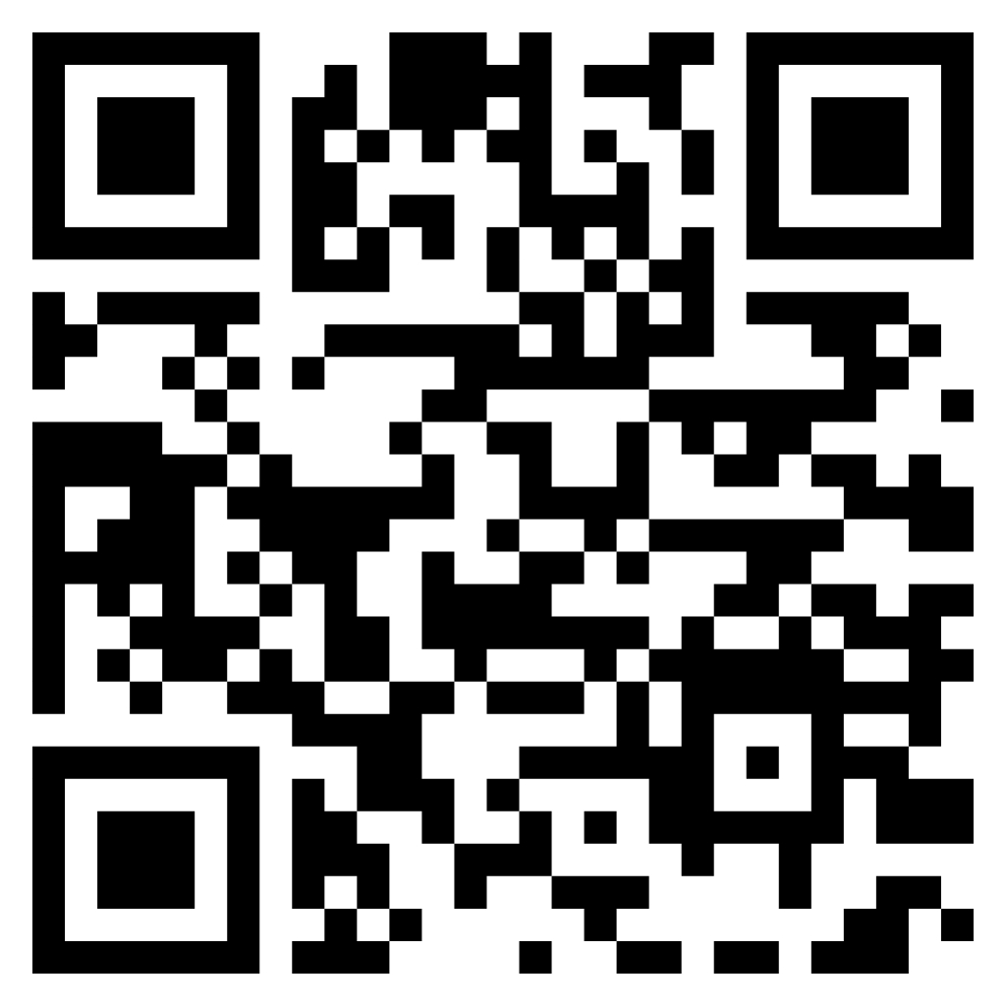
Have you attended any of the OARSI Live webinars?
The OARSI Engagement Committee is looking for feedback and ideas for improving the OARSI Live webinars.
Provide your feedback here:

Slide 12
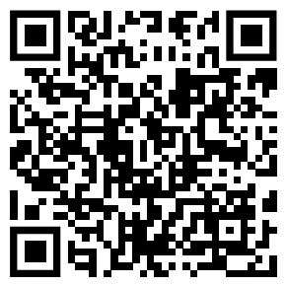
Are you interested in participating in this year’s OAC/OAC Open Peer Reviewer Training Program?
Interact with other trainees and investigators from around the world
Become familiar with the peer-review process
Receive constructive feedback to further develop your peer reviewing skills
The program will run from July 2025 to April 2026.
Apply by May 2nd!

Slide 13
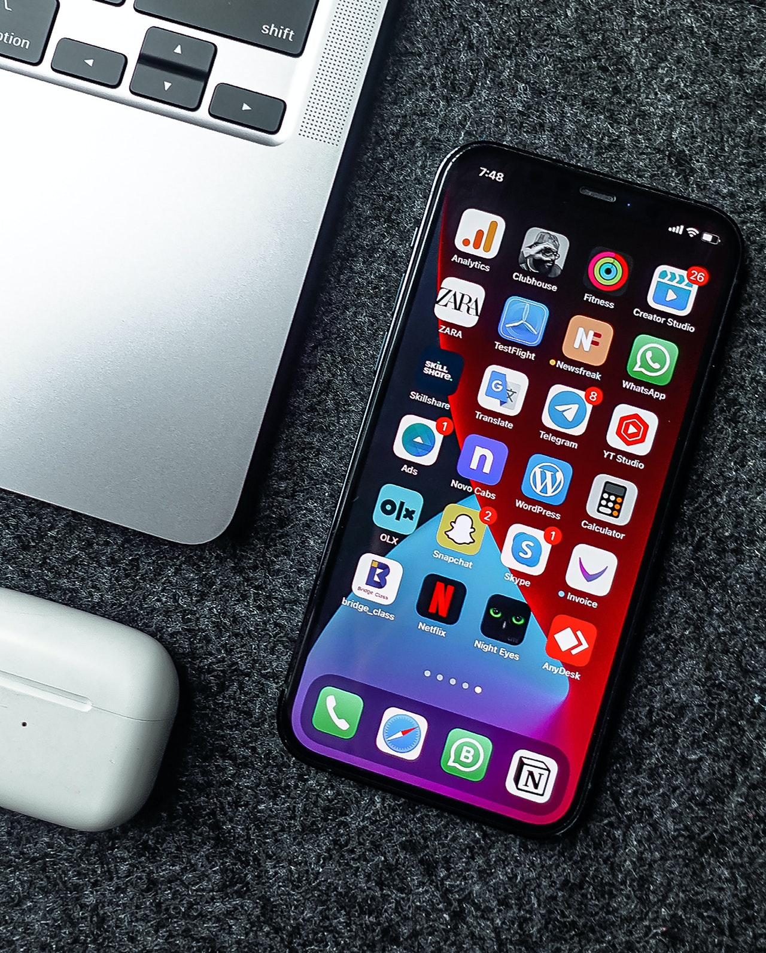
Please remember to mute your cell phone during presentations.
Thank you!

Slide 14
Get Involved!
We need you!
Volunteer to serve on an OARSI committee.
https://oarsi.org/volunteer
Upcoming Deadlines
August 31, 2025: Board nominations due
December 31, 2025: apply to serve on committees in next year’s cycle
January 22, 2026: Award nominations due
January 10, 2026: Travel Scholar applications due
https://oarsi.org/membership/awards-and-scholarships

Slide 15
Discussion Group Schedule
Human Movement Biomechanics (Friday, 12:30) - Room 205
Joint Effort Initiative (Friday, 12:30 pm) – Room 204
Imaging (Saturday, 12:30) – Room 206/207
Multimorbidity (Thursday, 12:30) – Room 208
OA Pain (Thursday, 12:30 pm) – Room 204
Regenerative Medicine (Friday, 12:30) – Room 206/207
OA Rehabilitation (Saturday, 12:30) – Room 204
Spinal OA (Friday, 12:30) – Room 208

Slide 16
Congratulations: Highest Rated Abstracts
Mylène Paulien Jansen
Zhaoyang Liu
Kevin Grant Burt
Adrienne A. Giannone
Xiaobo Shawn ZHU
Wan Ting Yan
Filippo Recenti
Monica Toft Hannani
Sujin Noh

Slide 17
Announcing 2026 Travel Exchange Scholars!
Lara Chapman
Andrea Dell’Isola
Asmaa El Maarbani
Bipin Ghimire
Rebecca Ramalho
Pietro Rubortone
Notes:
Pan Robertson Chong - University of Malaya traveling to Oakland University
Kai Feng - Shanghai Sixth People's Hospital traveling to University of North Carolina
Travis Haber University of Melbourne traveling to University of Southern Denmark
Monica Hannani - University of Copenhagen traveling to Newcastle University
Chelsea Martin - University of North Carolina traveling to University of Calvary
Ghaida Nahdi - Tunis Faculty of Medicine traveling to Erasmus MC

Slide 18
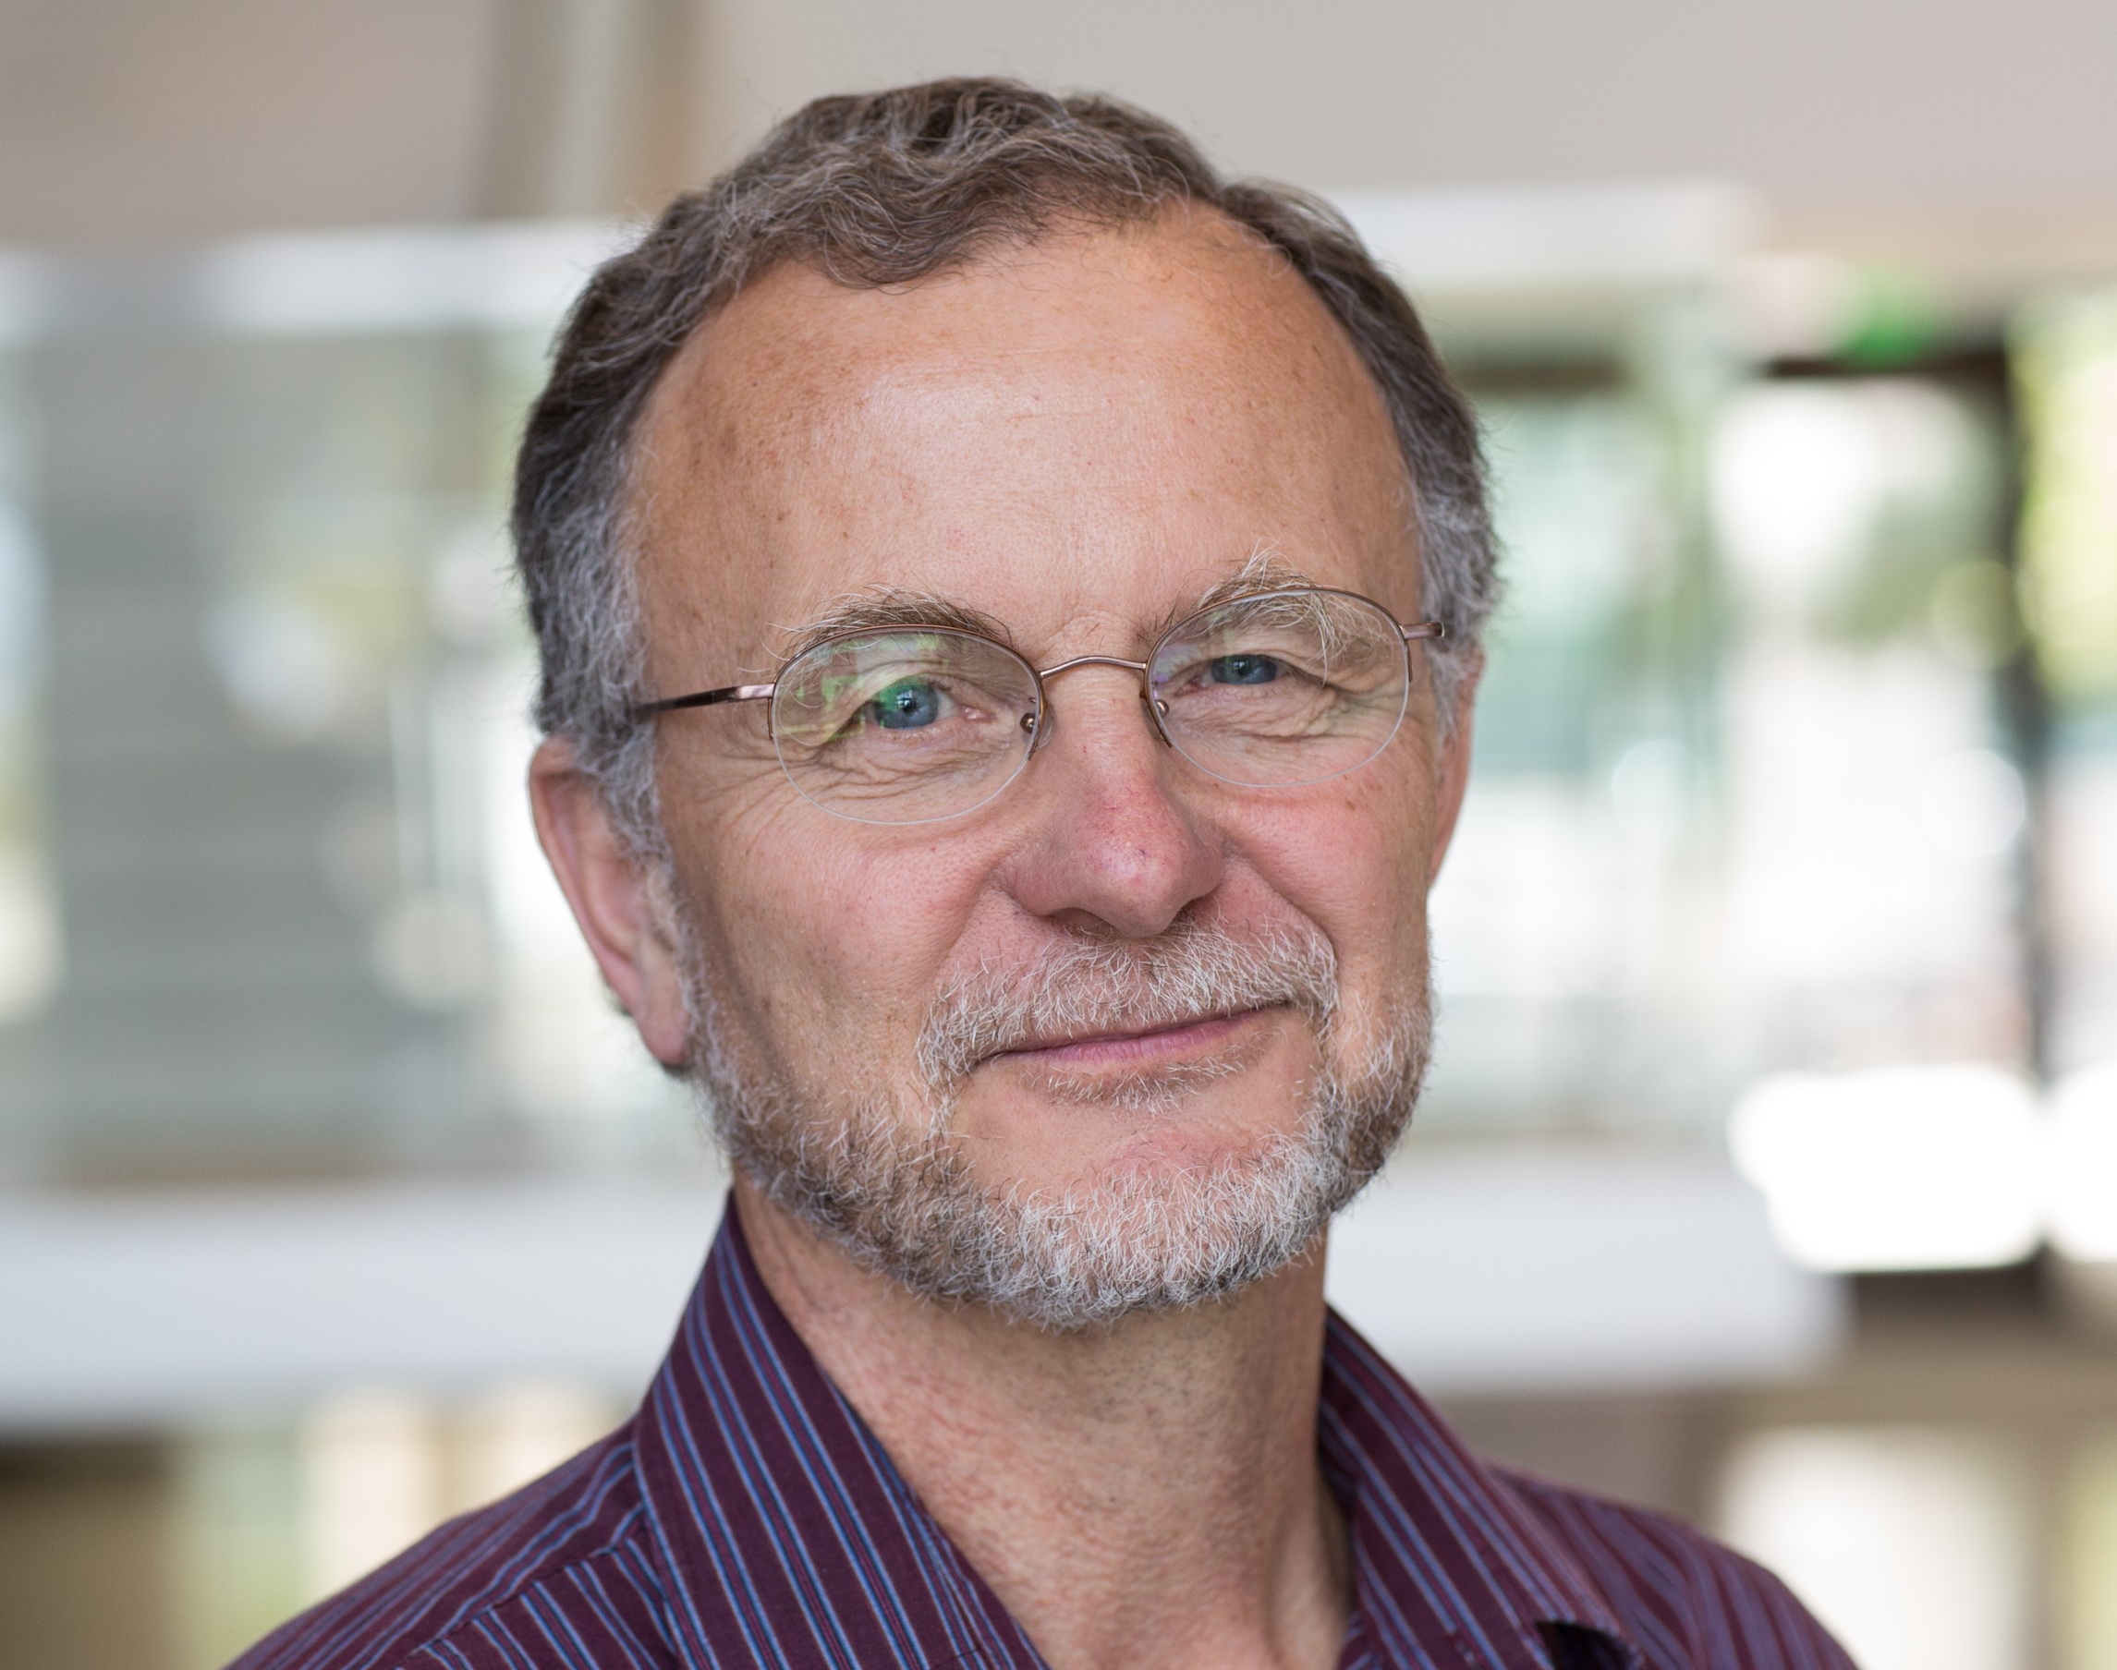

Lifetime Achievement Award
Michael Nevitt, PhD
University of San Francisco, US
The Lifetime Achievement Award is intended to honor a person who has devoted much of their career to the advancement of the science associated with osteoarthritis.

Slide 19
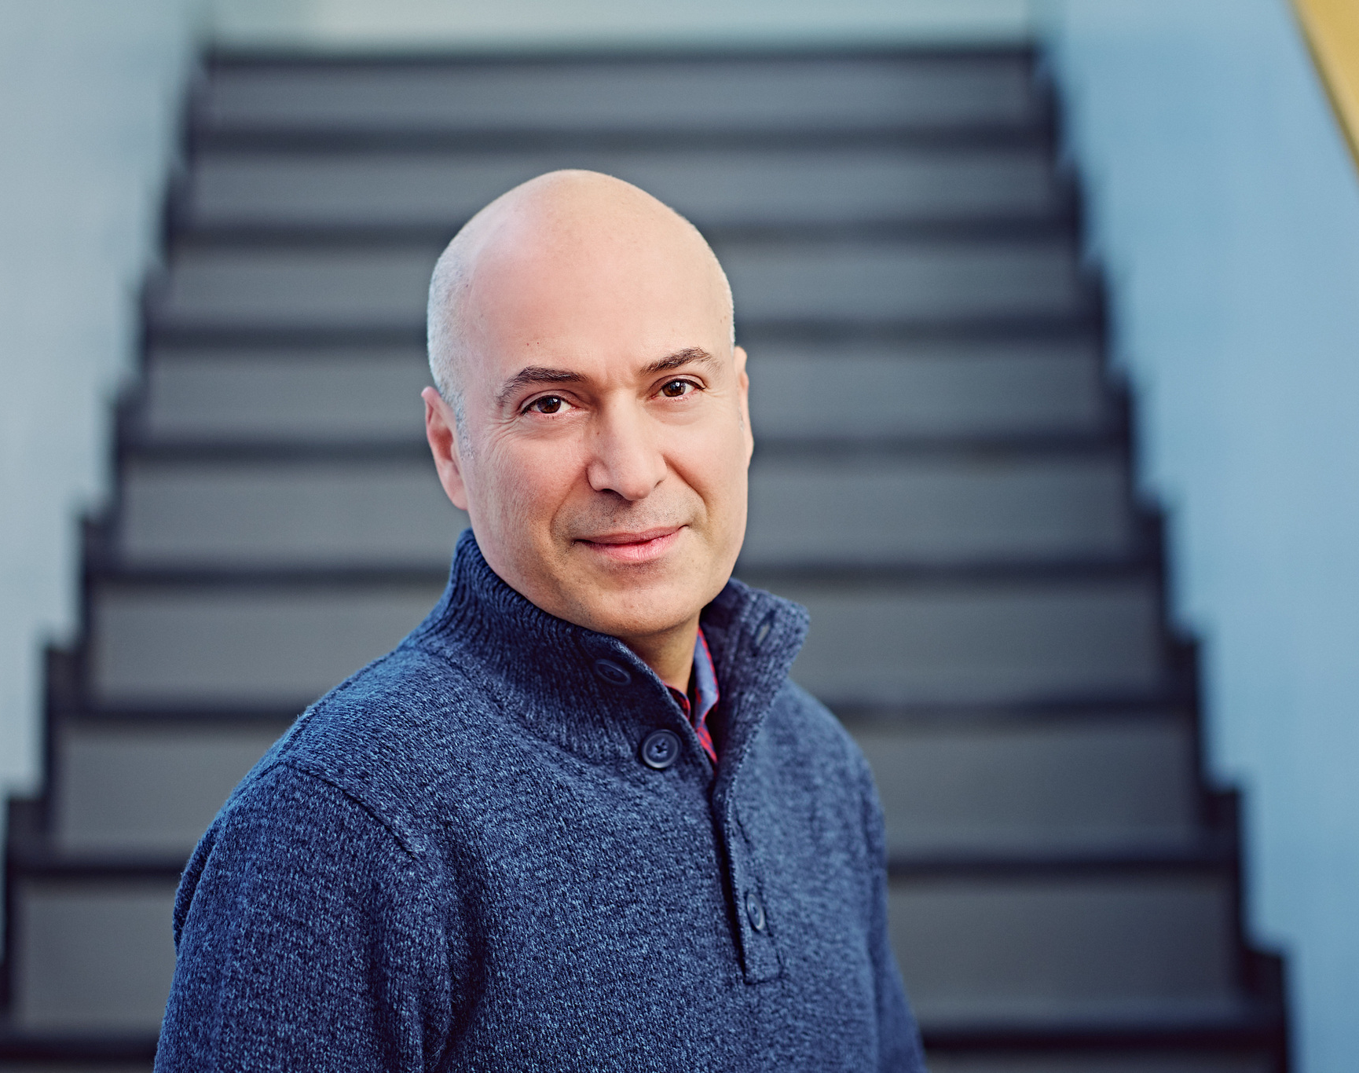
Basic Science Research Award
Ali Mobasheri, DPhil (Oxon)
University of Oulu, Finland
The purpose of the OARSI Basic Science Research Award is to promote advancement and recognize excellence in basic science research in the field of osteoarthritis.

Slide 20
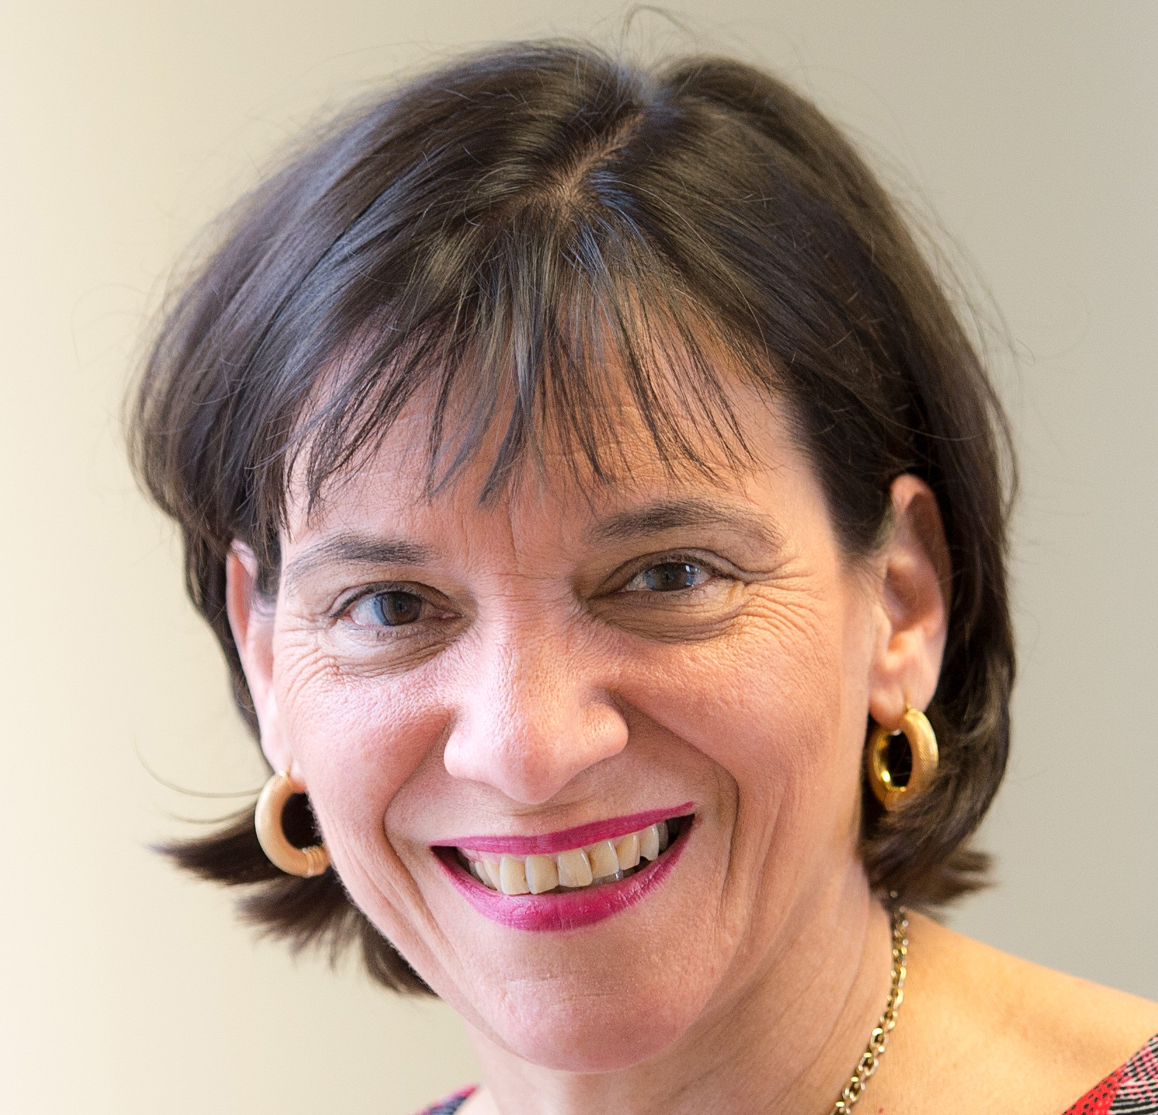
Clinical Research Award
Flavia Cicuttini, PhD, FRACP
Monash University, Australia
The purpose of the OARSI Clinical Research Award is to promote advancement and recognize excellence in clinical research related to osteoarthritis.

Slide 21
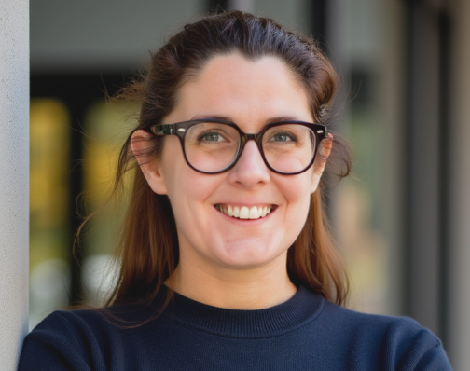
Rising Star Basic Science Research Award
Sarah Rice, PhD
Newcastle University, UK
The Rising Star Awards recognize excellent contributions from early career researchers (received terminal degree less than 10 years ago) within basic and clinical research in the OA field.

Slide 22
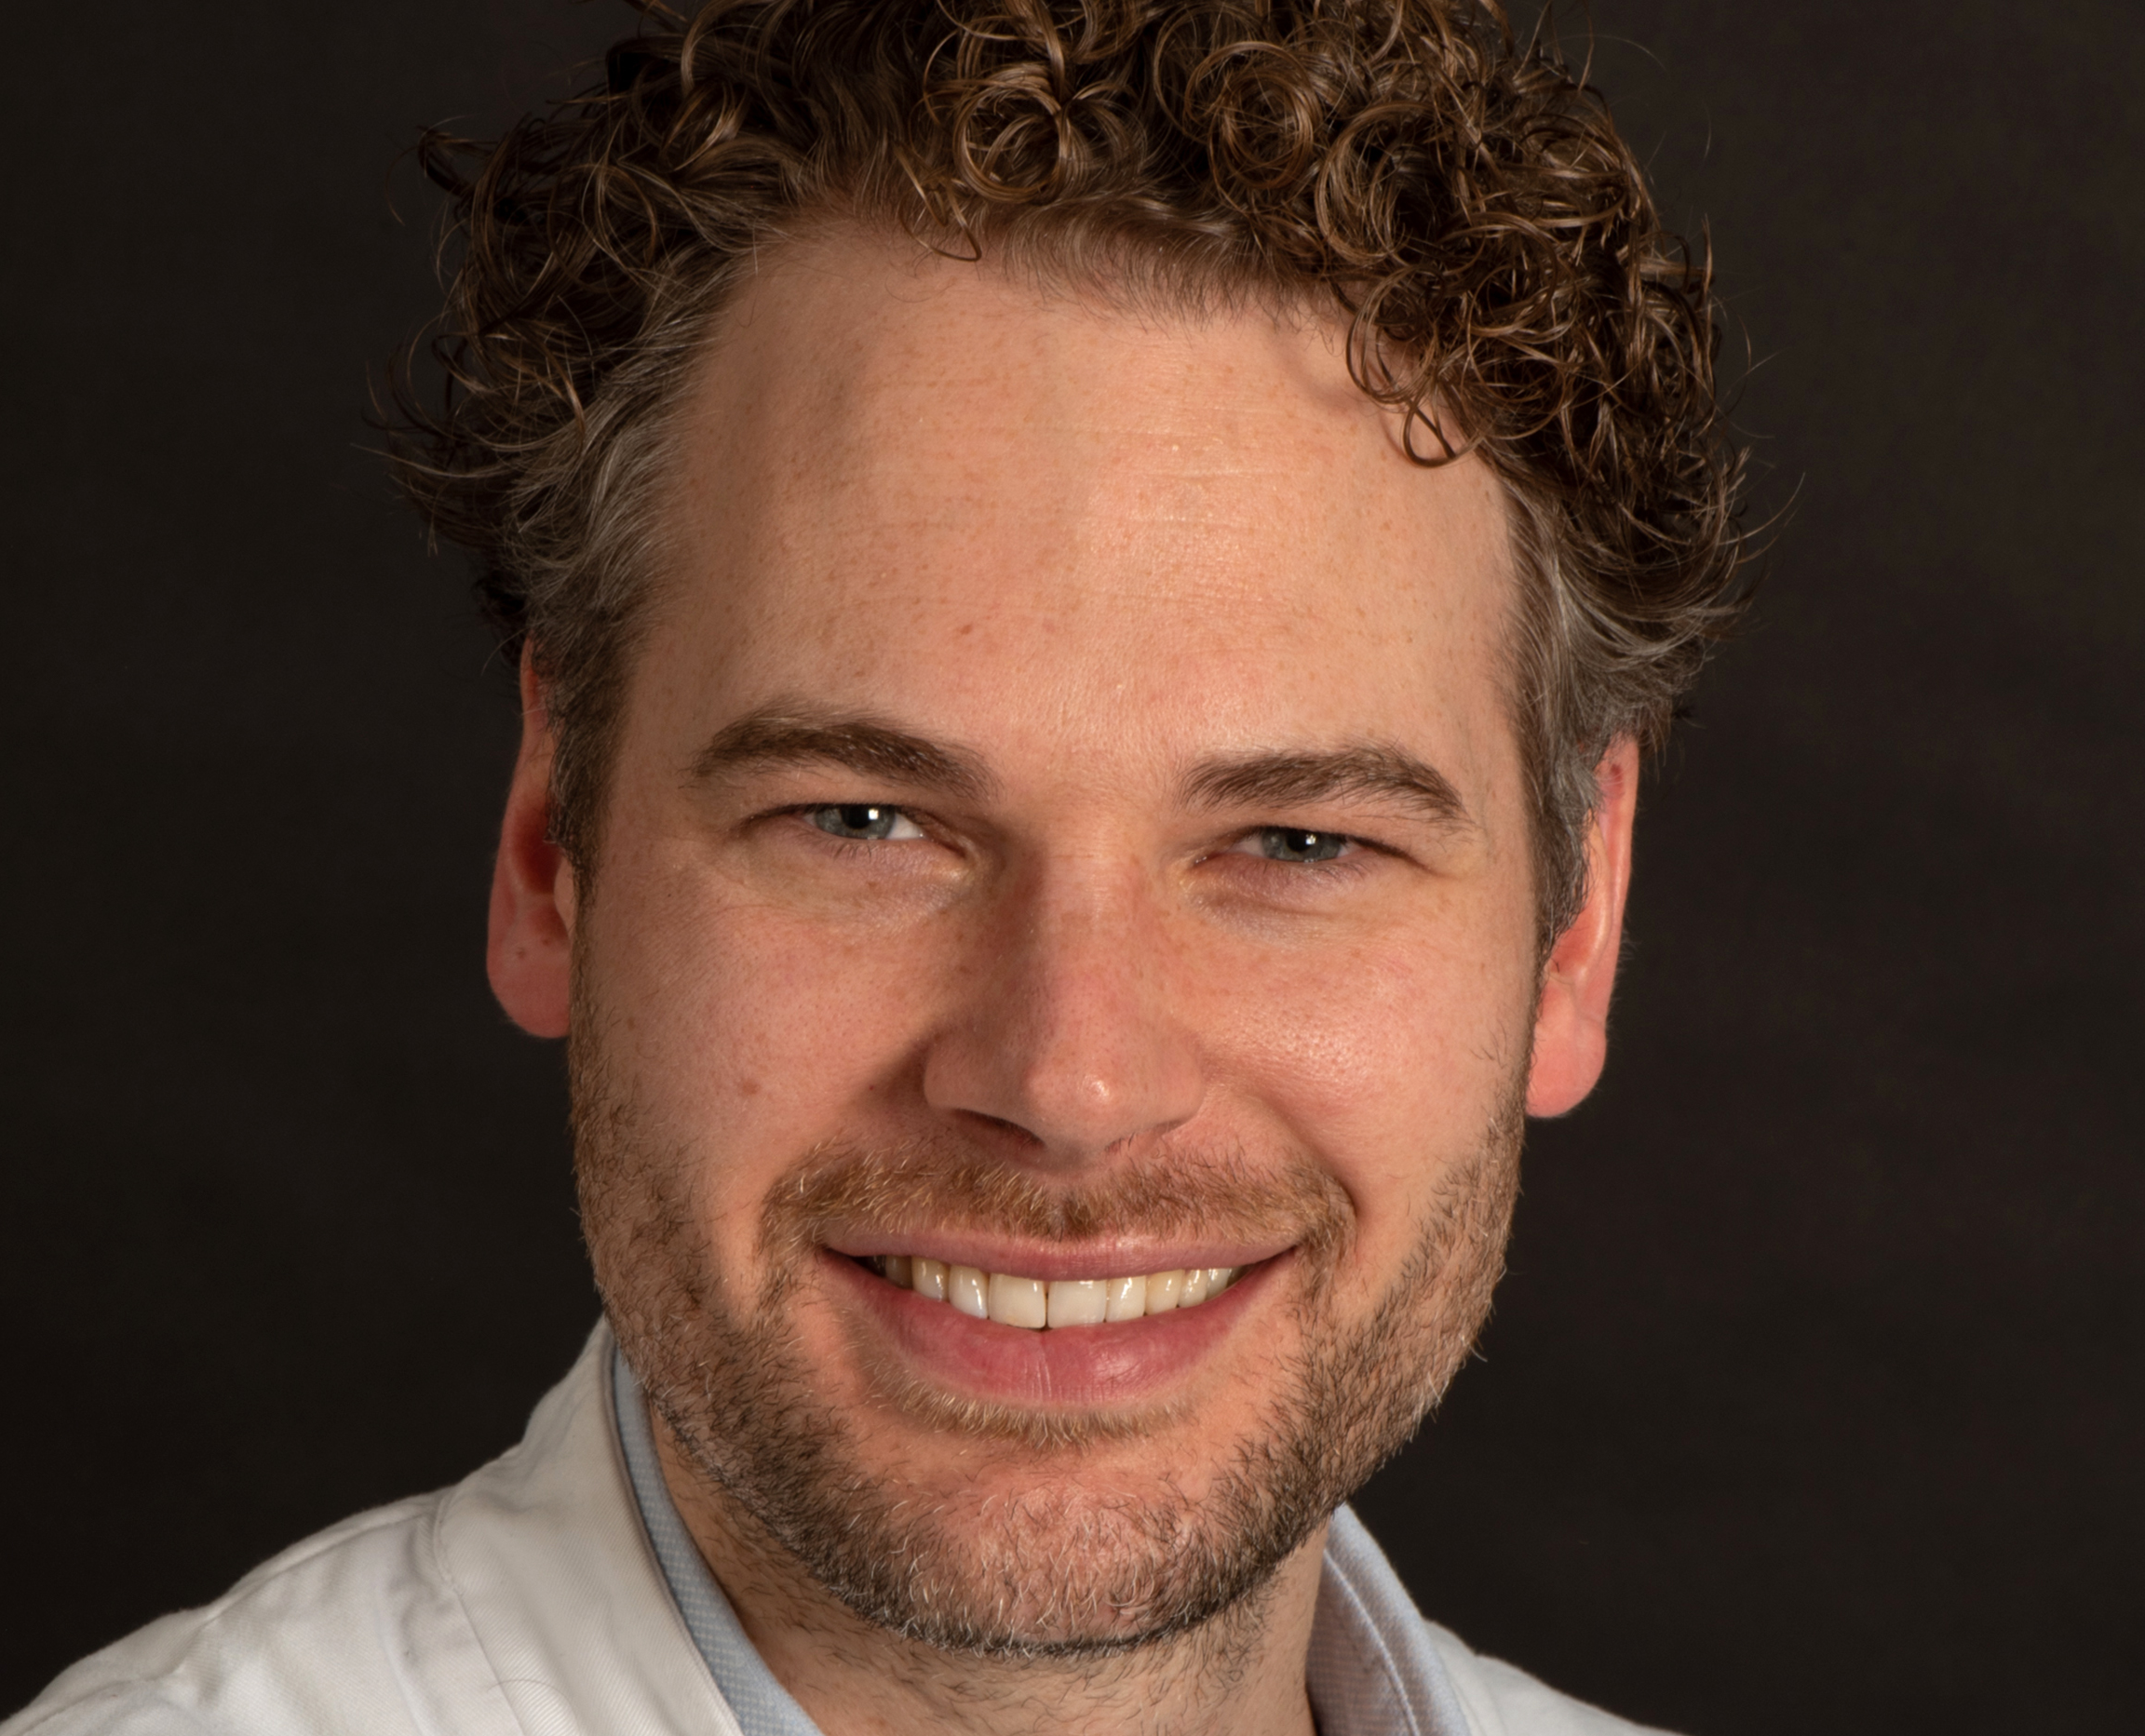
Rising Star Clinical Research Award
Rintje Agricola, MD, PhD
Erasmus University, The Netherlands
The Rising Star Awards recognize excellent contributions from early career researchers (received terminal degree less than 10 years ago) within basic and clinical research in the OA field.

Slide 23
Please remember to mute your cell phone during presentations.
Thank you!

Slide 24
Access Wifi
Download the Mobile App

Slide 25

2027 World Congress on Osteoarthritis April 1-4, 2027 Convention Center Barcelona, Spain
Save the Date!

Slide 26
2028 World Congress on Osteoarthritis May 2028 Asia
Save the Date!
Notes:
https://youtu.be/-B7oEuiWKB0

Slide 27

Title Goes Here
Name & Credentials Go Here

Slide 28

Title Here
Text Here

